Slide 1
Are we experimenting on people?
Ethics

Slide 2

Steph Locke
Data Scientist
Microsoft AI & Data Platform MVP
@TheStephLocke
steph@itsalocke.com

Slide 3

Agenda
Are we experimenting on people?
What are our ethical obligations?
How do we embed ethics into our processes?
How do we tackle the technical challenges?

Slide 4
Human Subject Research
Individuals
Data capture
Human Subject Research
Notes:
https://en.wikipedia.org/wiki/Human_subject_research
a human research subject as a living individual about whom a research investigator (whether a professional or a student) obtains data through 1) intervention or interaction with the individual, or 2) identifiable private information
"Intervention"- physical procedures by which data is gathered and the manipulation of the subject and/or their environment for research purposes
“Interaction"- communication or interpersonal contact between investigator and subject
"Private Information"- information about behavior that occurs in a context in which an individual can reasonably expect that no observation or recording is taking place, and information which has been provided for specific purposes by an individual and which the individual can reasonably expect will not be made public
"Identifiable information"- specific information that can be used to identify an individual.

Slide 5
Common data science projects
Churn
PPC optimisation
Credit worthiness
Recommendations
Timeline ordering

Slide 6
Researcher obligations
Informed consent
Respect
Right to opt-out
Benefits > costs
No harm
Provide information
Protect privacy

Slide 7
Why do we need to think about this?

Slide 8
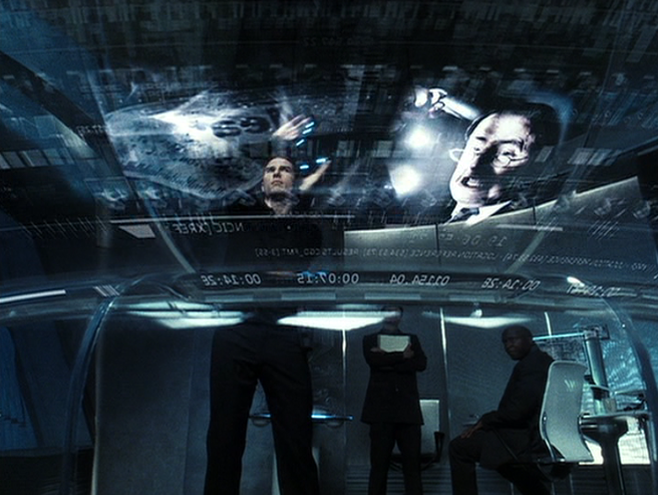
To avoid a dystopian future
This Photo by Unknown Author is licensed under CC BY-NC-ND

Slide 9
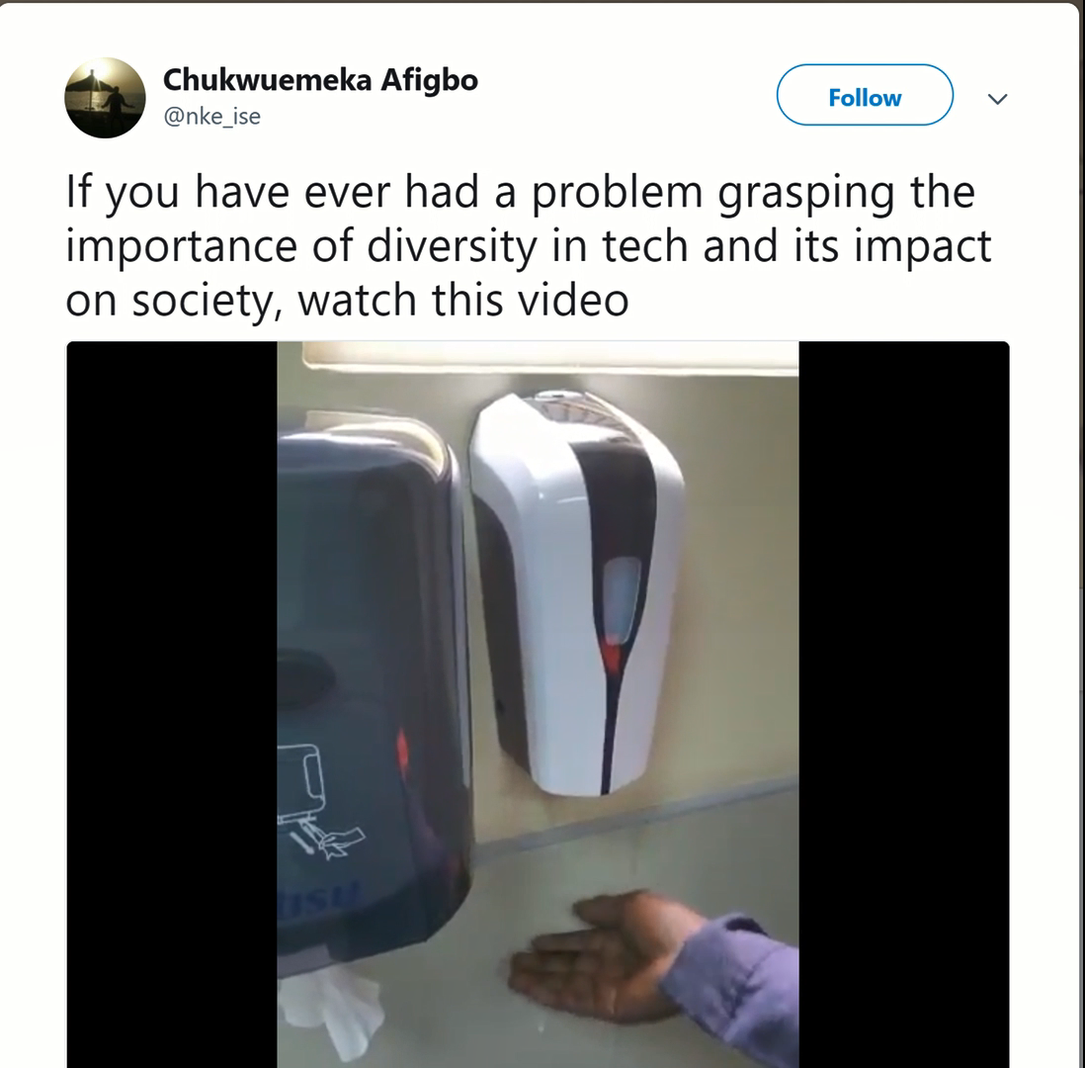
To not be (inadvertently) ____ist
https://blogs.microsoft.com/ai/gender-skin-tone-facial-recognition-improvement/ https://twitter.com/nke_ise/status/897756900753891328

Slide 10
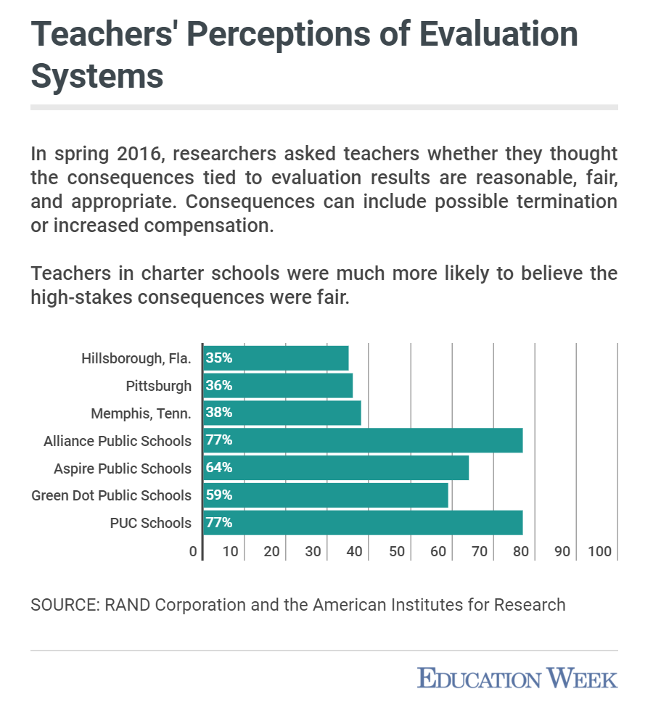
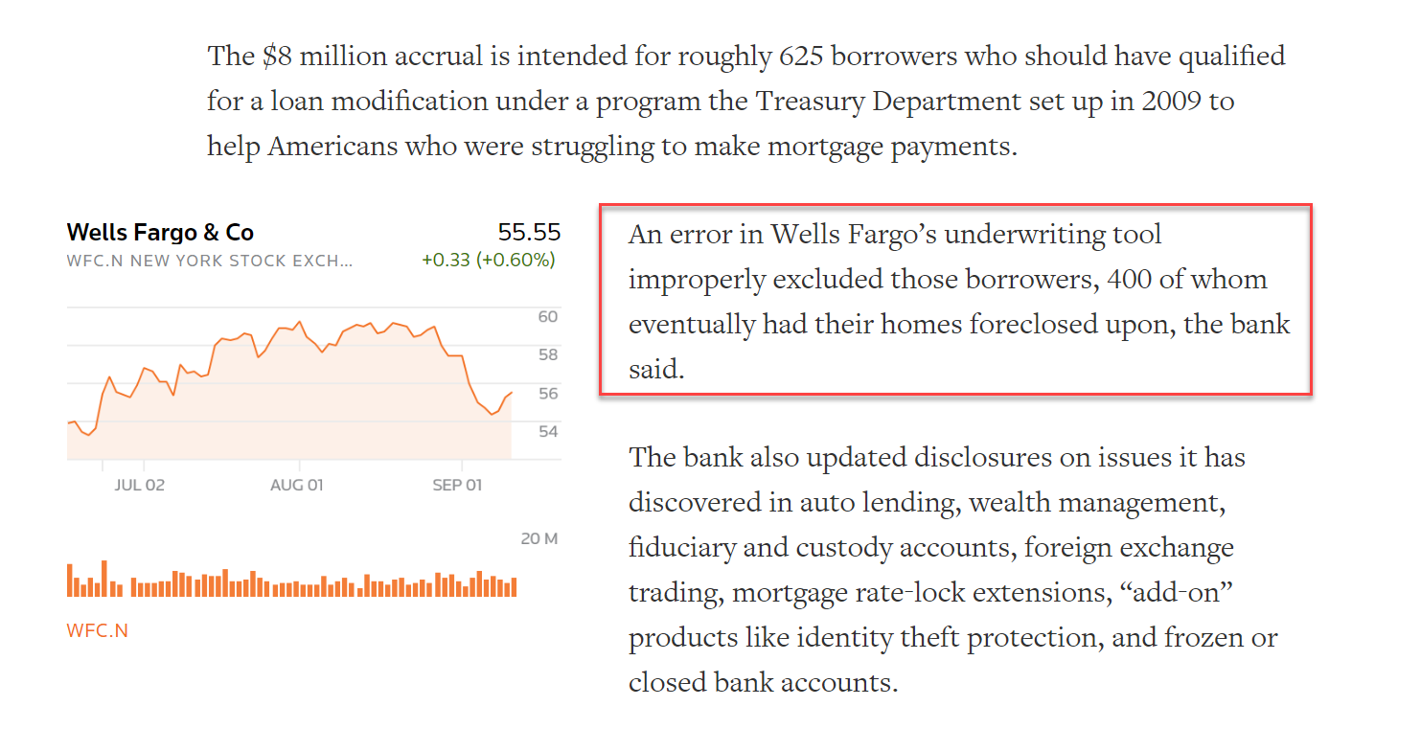
To avoid destroying lives
https://money.cnn.com/2018/08/04/news/companies/wells-fargo-mortgage-modification/index.html
https://www.edweek.org/ew/articles/2018/06/21/an-expensive-experiment-gates-teacher-effectiveness-program-show.html

Slide 11
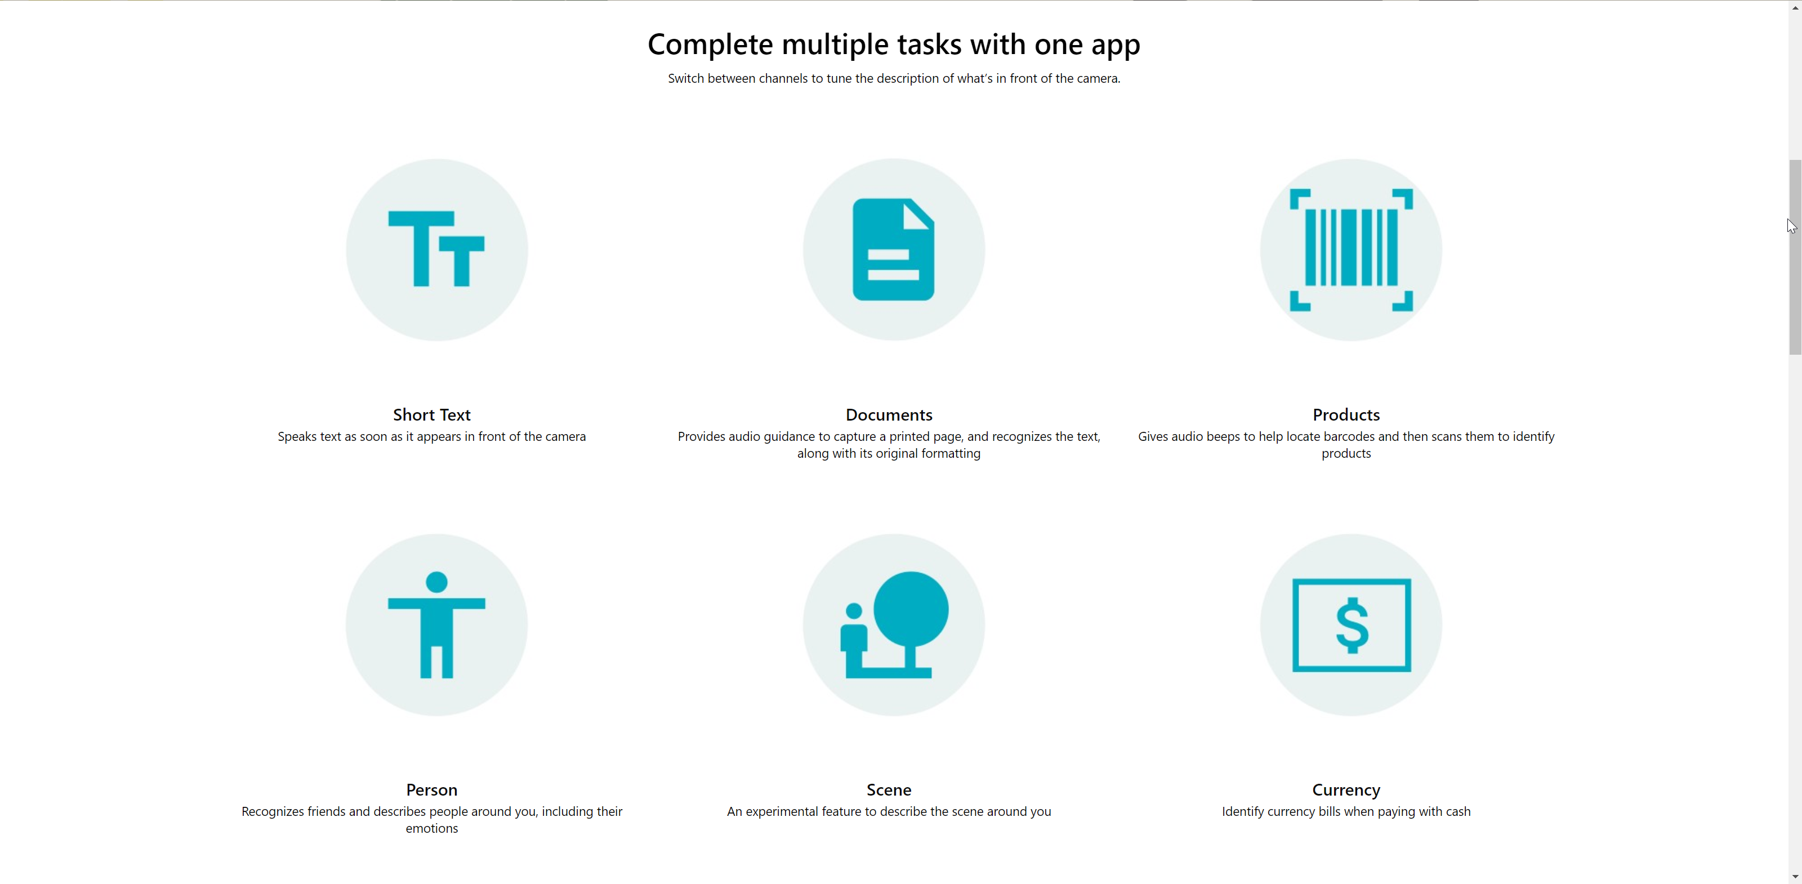
To feel good about what we do
https://www.microsoft.com/en-us/seeing-ai

Slide 12
How does this translate to a business context?

Slide 13
(Unintended) Consequences
Type I and II errors
Change in behaviours
Financial, medical, or political impacts

Slide 14
The responsibilities of the (data) scientist
Consider and plan
Guide implementation
Refuse to do harmful work and/or whistleblow?
Determine monitoring to identify potential harm

Slide 15
Responsibilities of the company
Legal
Shareholders
Be customer-centric?

Slide 16
What do we need to do?

Slide 17
Education
Communicate about ethics internally
Run workshops to help understand implications scu.edu/ethics-in-technology-practice
Share stories about what data scientists fail to be ethical

Slide 18
Frameworks
Initial impact assessments
Plans and checklists
Test strategies and harnesses
ainowinstitute.org/aiareport2018.pdf
www.gov.uk/government/publications/data-ethics-framework/data-ethics-framework

Slide 19
5 concepts of fairness
group unaware - same cutoff points / decision boundary
group thresholds - different cutoff points to allow different volumes in
demographic parity - different cutoff points to end up with distribution like overall demographics
equal opportunity - the same true positive rate holds across groups
equal accuracy - the same overall accuracy rate holds across groups
Notes:
group unaware - same cutoff points / decision boundary. Will encounter problems if protected characteristics or proxies are included
group thresholds - different cutoff points to allow more of a class in. Open to positive discrimination complaints.
demographic parity - acceptance rate determined to end up with a portfolio makeup that resembles overall demographic proportions. Can result in more rejections in majority cases
equal opportunity - the same true positive rate holds across groups
equal accuracy - the same overall accuracy rate holds across groups

Slide 20
Data
Legal and contractual requirements
Anonymisation and maintaining privacy
Consultation processes

Slide 21
Show me the tech!

Slide 22
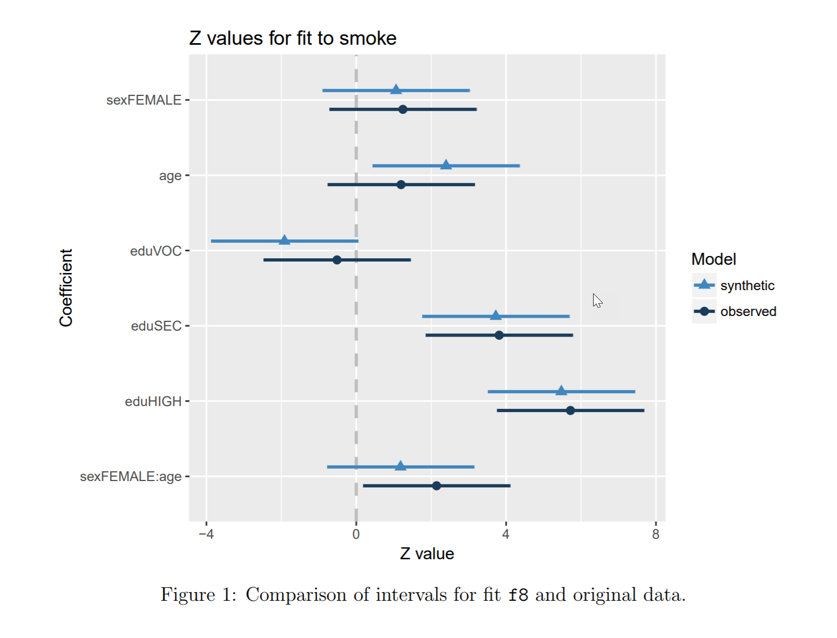
Synthetic data
https://cran.r-project.org/package=synthpop

Slide 23
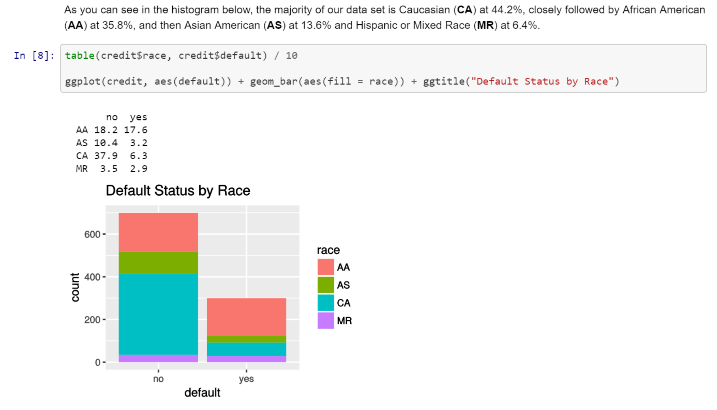
EDA
https://github.com/ropenscilabs/proxy-bias-vignette/blob/master/EthicalMachineLearning.ipynb

Slide 24
Testing
Functions for fairness concepts
Analysis by groups
Pen portrait / “Typical” entries

Slide 25
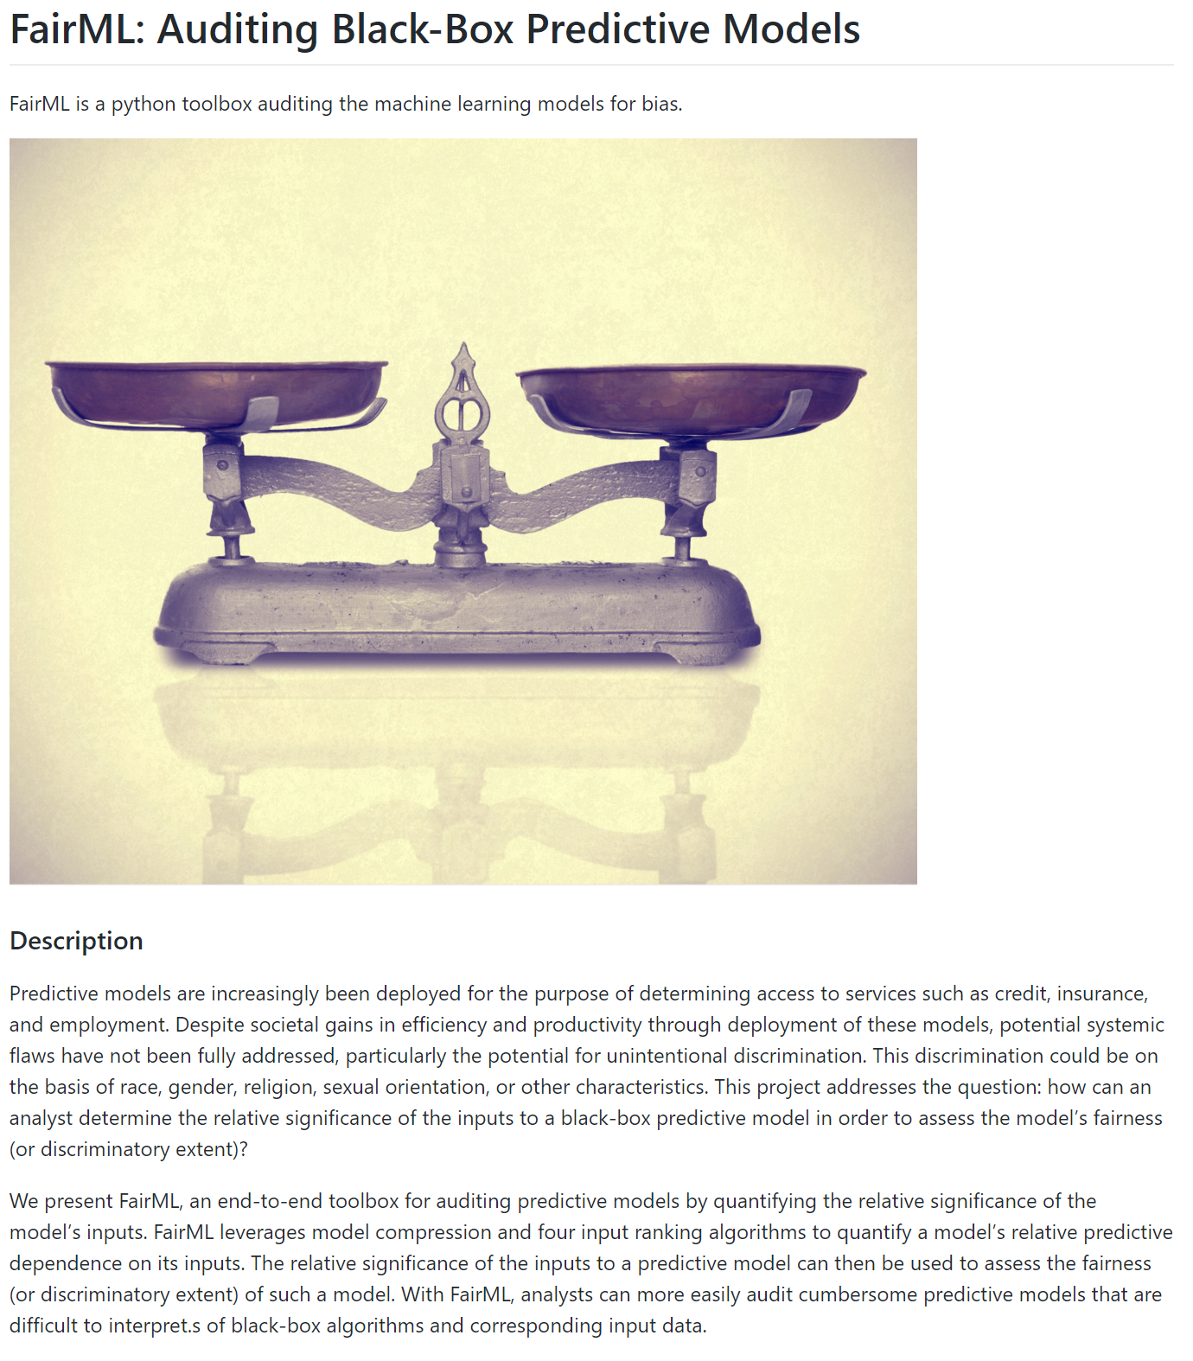
Testing
https://github.com/adebayoj/fairml

Slide 26
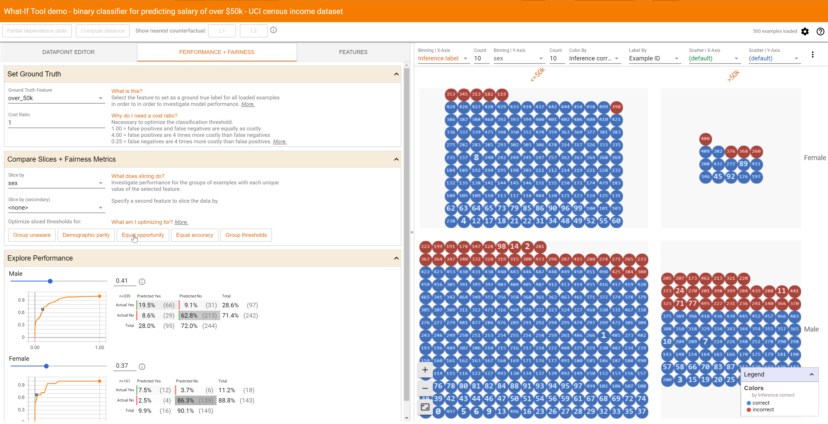
Testing
https://pair-code.github.io/what-if-tool/uci.html

Slide 27
Monitoring
Protected characteristics
Spot checks and counter factuals

Slide 28
Security
Adversarial behaviours
Robustness
Retro-engineering
Lessons from security – Red and Blue Teams?

Slide 29
Thanks!
@theStephLocke
itsalocke.com/talks
bit.ly/ethicaldatasciencelinks

